Slide 1

The Unstoppables
A Fortnite story

Slide 2

Heads up
The Unstoppables are a team of superheroes who defend Fortnite Isle 2
Their members include:
Drift the smart one
Flare the strongest
Infinity teleporter
Zero the gravity shifter
Advance men metal reinforcements
+ the Unstoppables enemy Raven

Slide 3

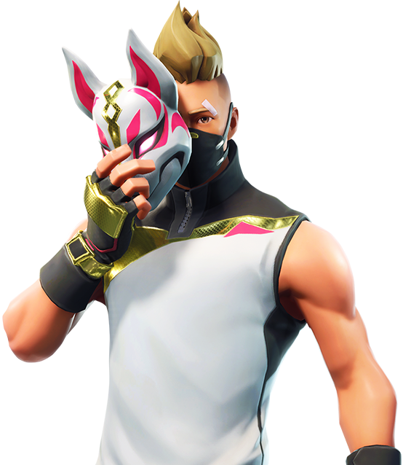
Drift
Powers: smart, electricity and can turn into electricity to zoom around the island
Favourite thing to do: riddles
Mega move: multiple lightning strikes
Hates: when his team don't listen

Slide 4

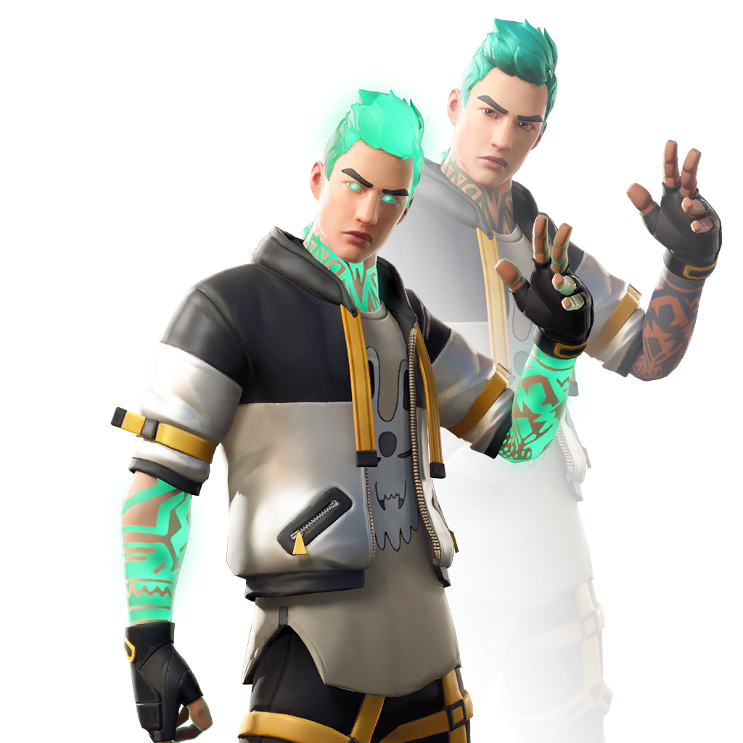
Flare
Powers: fire, smokescreen, enhanced strength, flight
Favourite thing to do: lift weights
Mega move: flame burst (immune to friends)
Hates: weak enemies

Slide 5
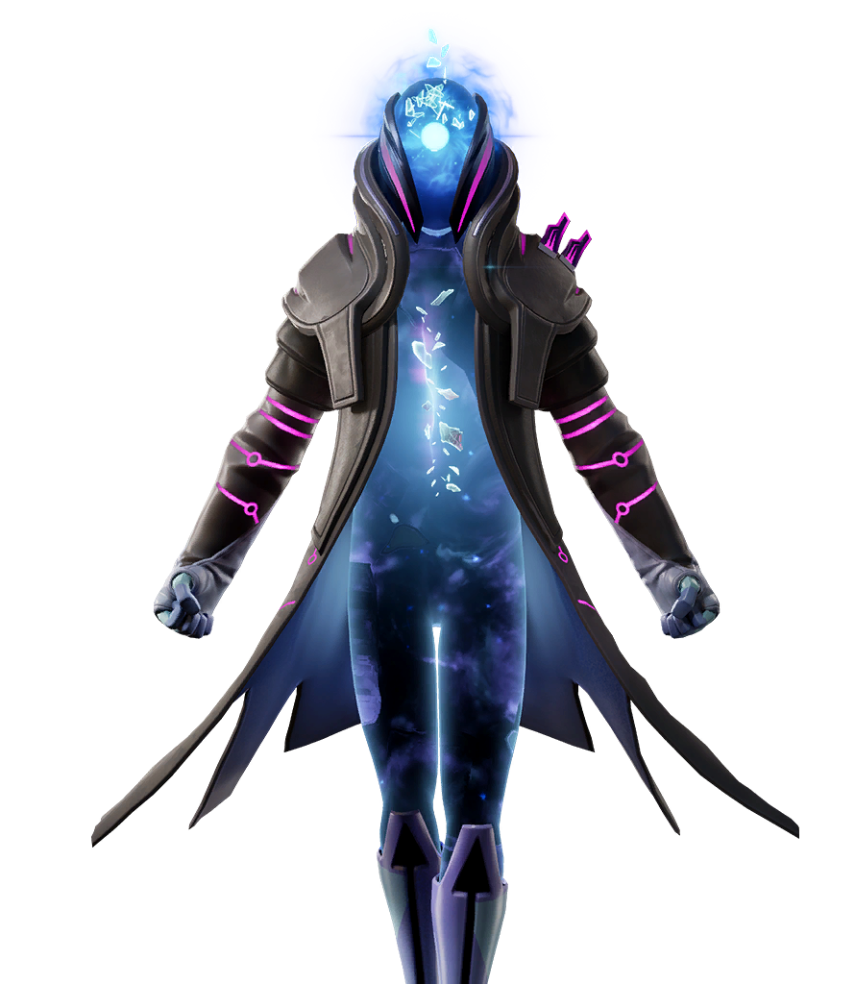
Infinity
Powers: teleportation, teleport people or objects to pocket dimension
Favourite thing to do: sightseeing
Mega move: drop items from the sky
Hates: small area fights

Slide 6
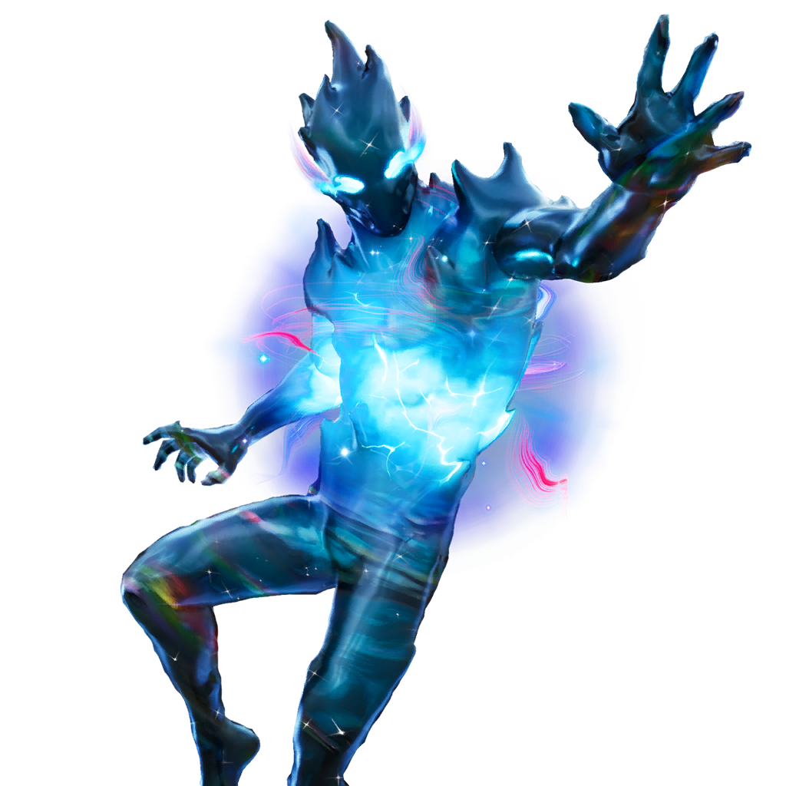
Zero
Powers: shift gravity, flight levitate people/objects
Favourite thing to do: break the laws of physics
Mega move: shift gravity therefore stunning the target/s
Hates: being restricted from his powers

Slide 7
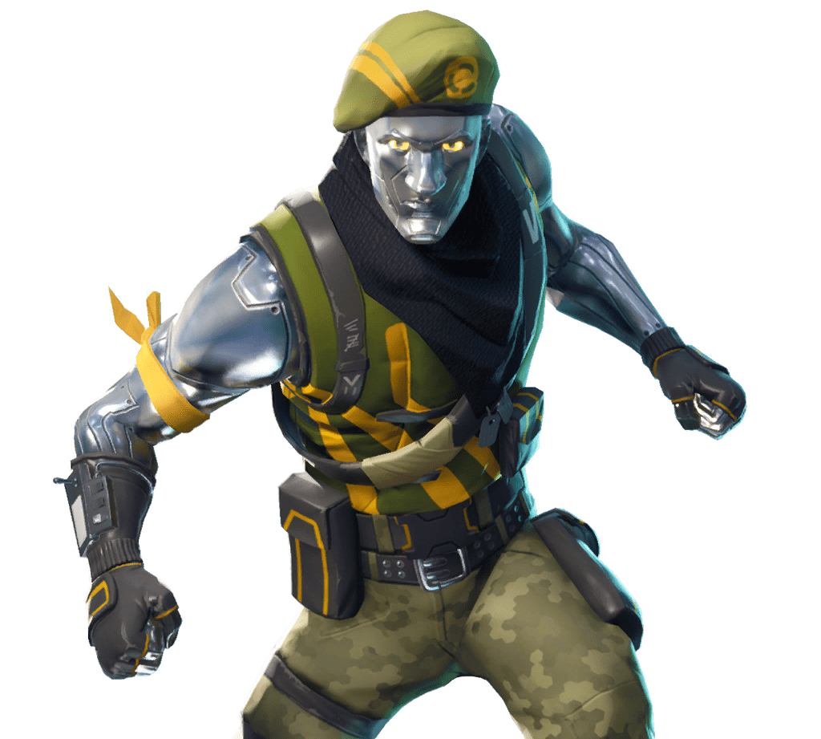
Advance men
Powers: enhanced strength, metal bulletproof skin
Likes: supporting their team
Mega move: none
Hates: fighting one enemy at a time

Slide 8
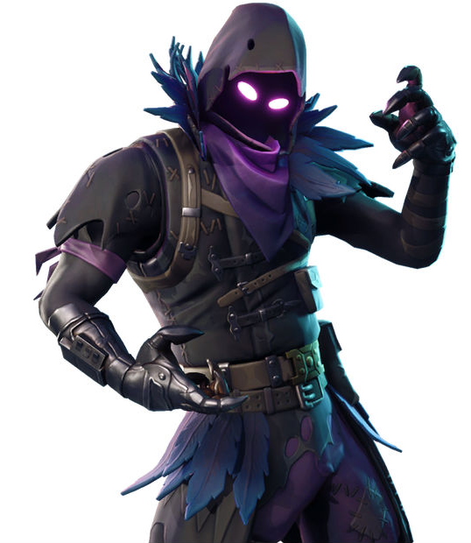
Raven
Powers: lightning, can summon cube fiends, can summon cube fiend spawners
Likes: to wreak havoc
Mega move: can surge low amounts of electricity for 45 seconds
Hates: the Unstoppables

Slide 9
Thank you
I hope you have enjoyed my PowerPoint now that you know all you need to know about the characters you can read the story
By Flynn Gibney

