Slide 1
Things I liked and did not like about p.4
Have a seat and enjoy

Slide 2

I liked a lot of p.4
In my school there was a lot of things going on so you were always kept busy but that’s the way I like it I had lots of friends and I learnt a lot but I couldn’t have done it without the teachers, friends, dinner ladys and helpers so I just wanted to say thank you.

Slide 3
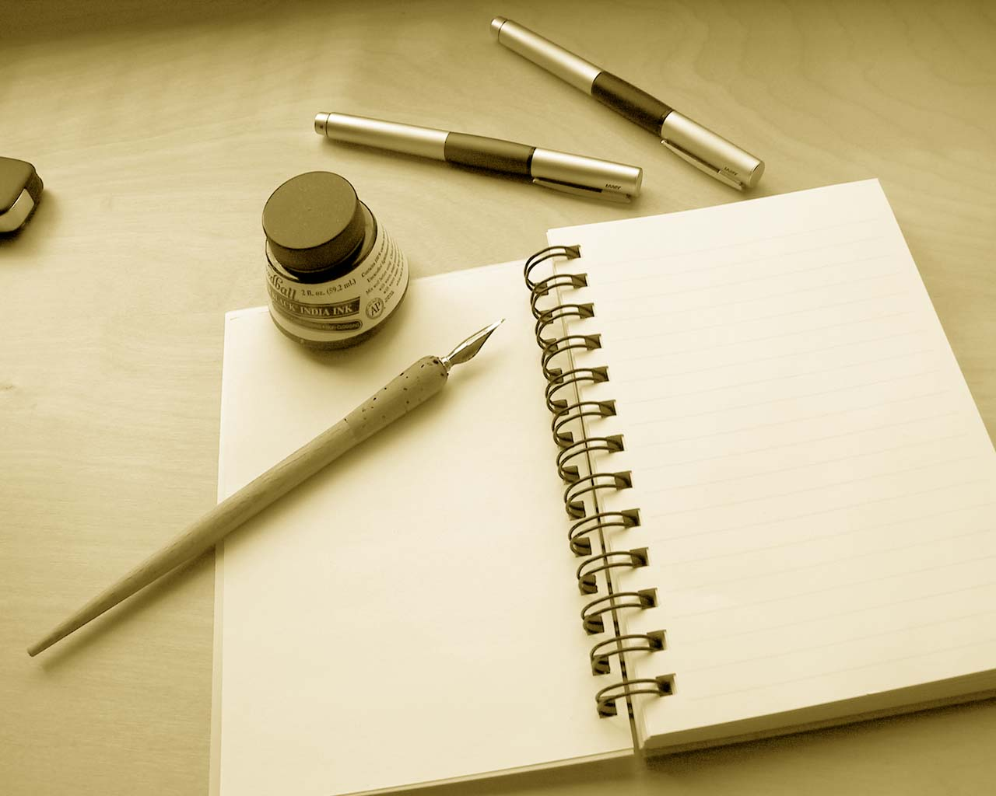
writing
I don’t really like writing but sometimes its best to get it over an done with.

Slide 4
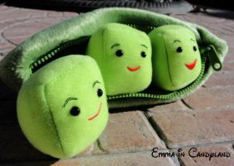


Slide 5


Slide 6
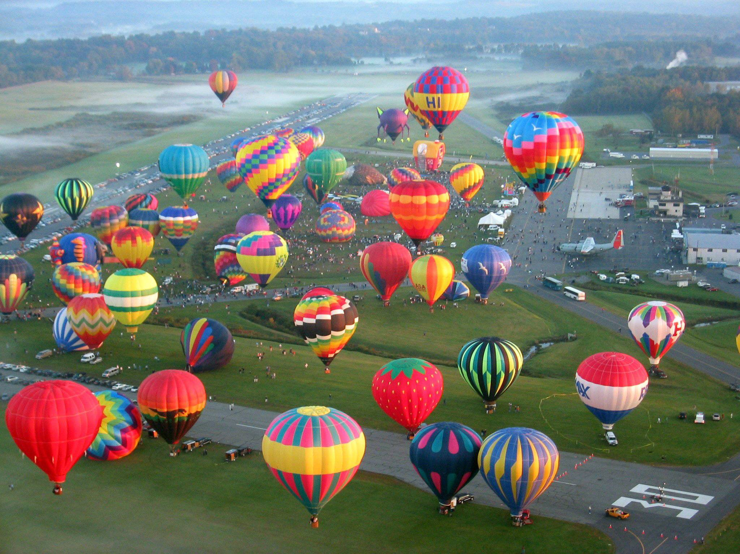
end
The end

Slide 7
