Slide 1
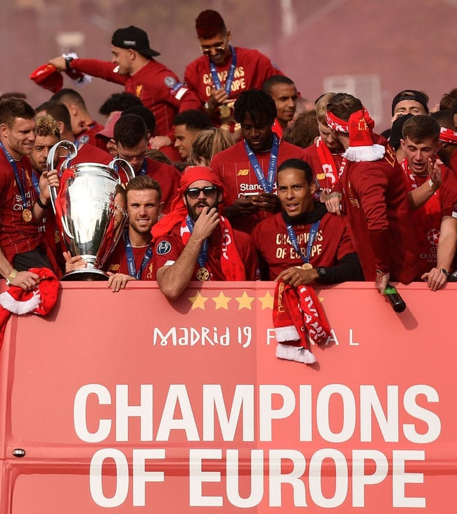

Liverpool
THE Klopp Effect

Slide 2

Champions League Final 2018
Click on image to see
Highlights
This was an unlucky
Game for Liverpool

Slide 3
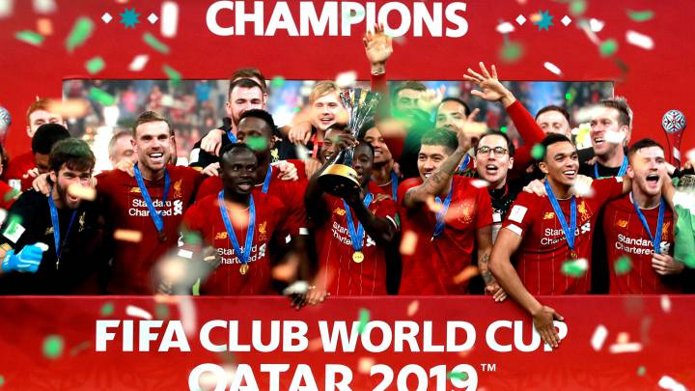
A winning year
2019 was an amazing year for Liverpool. They came second in the Premier League but played great football to win the Champions League. They also went on to win the World Club Championship in December.

Slide 4
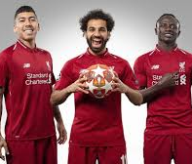
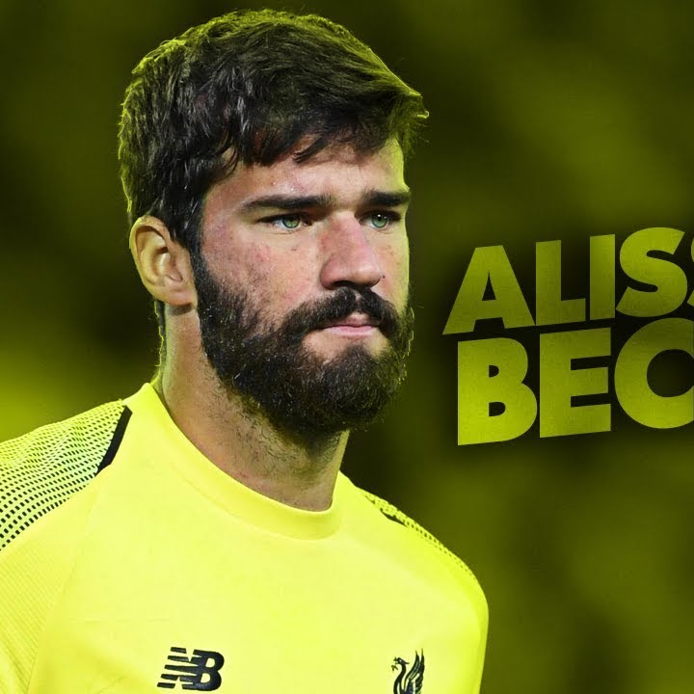

Top Tens in 2019
Top Alisson saves
Top Goals
Click on images to see video

Slide 5

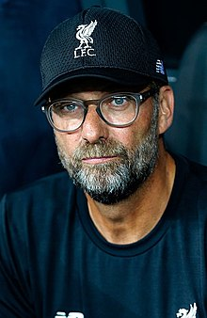
Klopp Fact File
Born: 16 June 1967 age 53 years, Stuttgart, Germany
Height: 1.91 m
Salary: 3.56 million GBP
Teams he played for: FSV Mainz 05
Teams he coached: 2001-2008 Mainz 05, 2008-2015 Borussia Dortmund,
2015- present Liverpool
Children: Marc Klopp

Slide 6
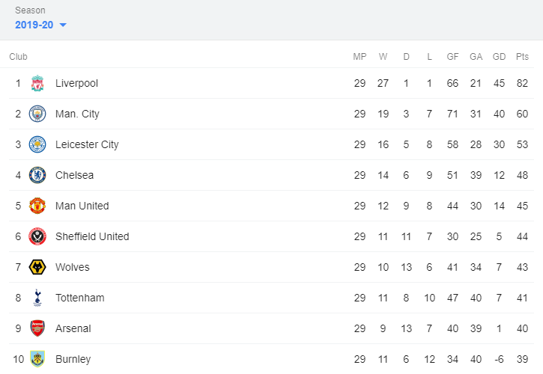
Premier League 2020
Two games off winning
the prem!!!
If we win against
Everton and Crystal Palace
we will be League
Champions 2019-2020 with
7 games remaining.

Slide 7

The Klopp Effect by Matthew Daly P6
Dreams do come true – Click on crest for surprise!

