Slide 1
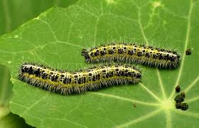
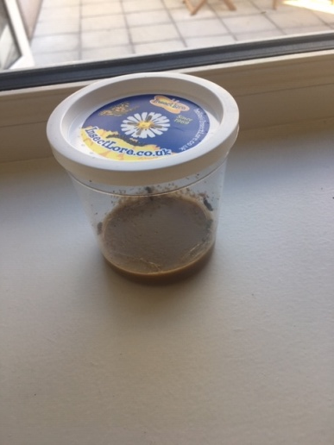
The Life of a Caterpillar by Joe Hegarty
One of my birthday presents was five caterpillars. They stayed in their tub eating and sleeping for 2 weeks.

Slide 2
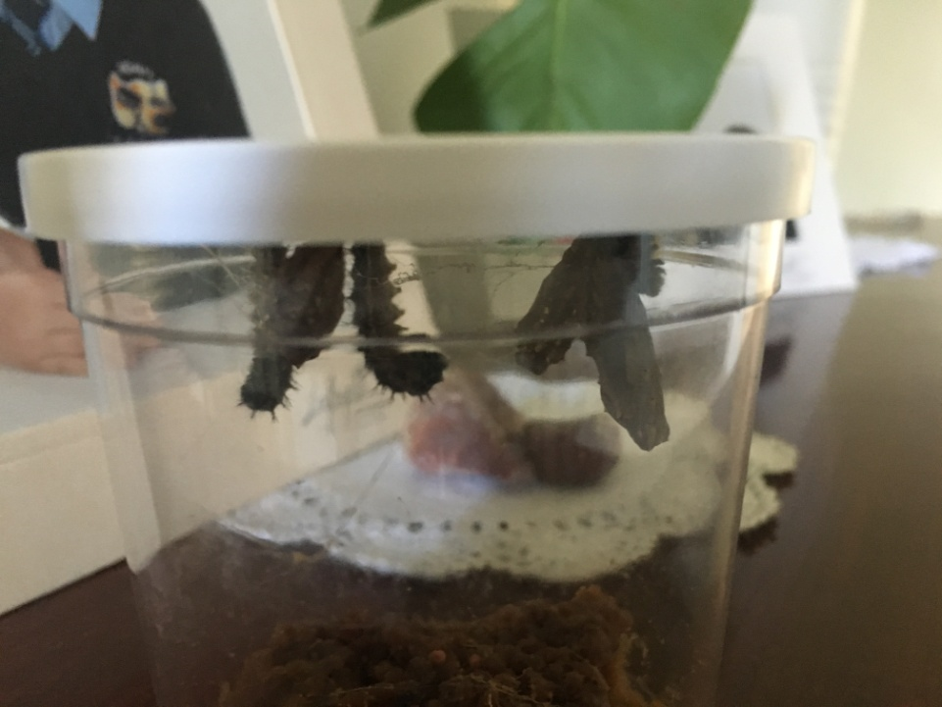
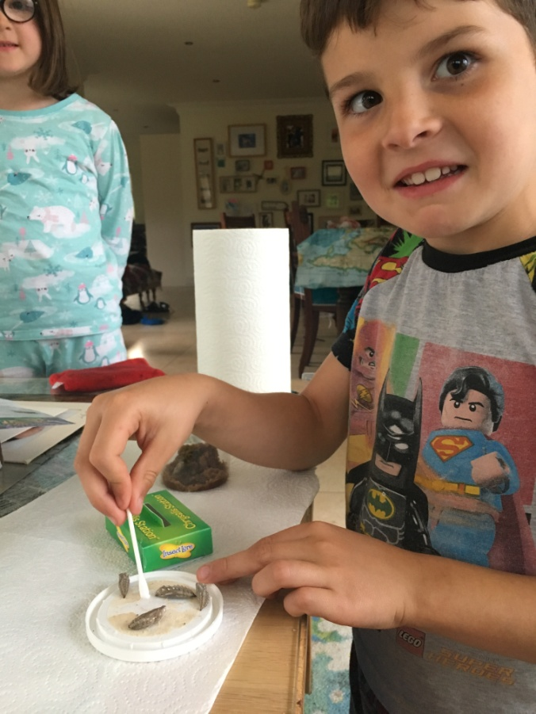
They got very big and moved to the lid
of the tub for a long sleep.
I cleaned the silk off their
hard shells with a cotton bud.

Slide 3
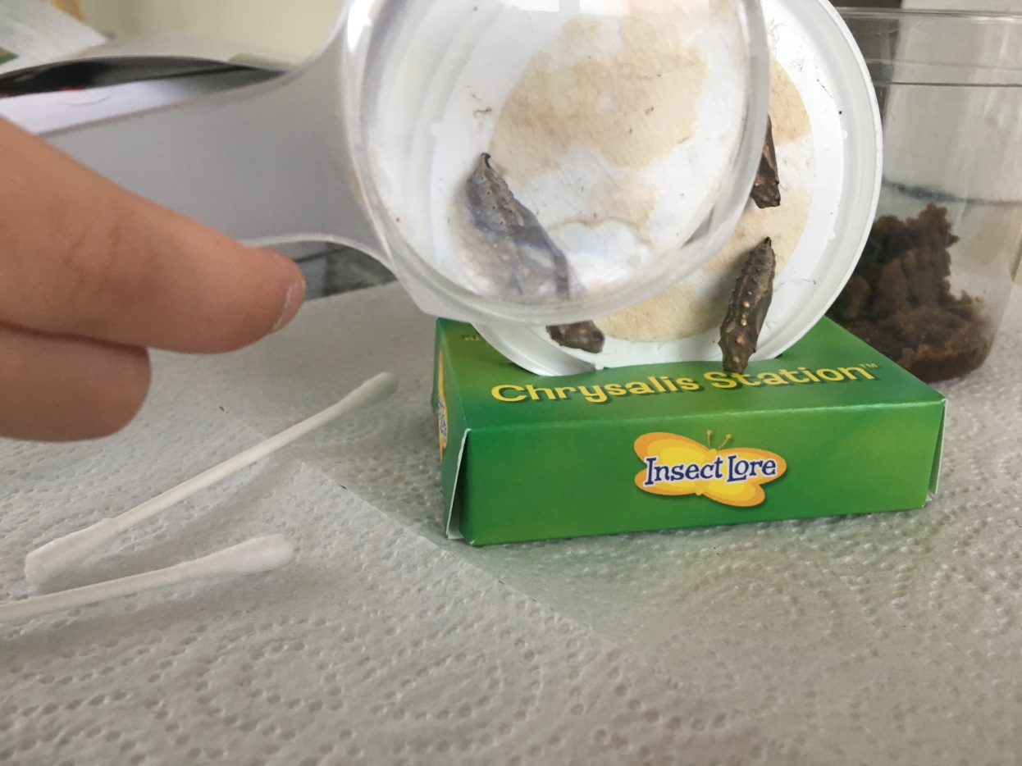
I moved the caterpillars to the
chrysalis station and into a big net.

Slide 4
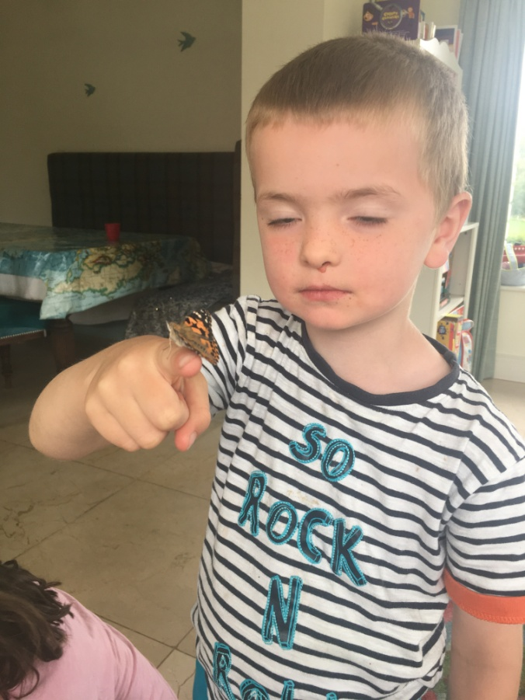
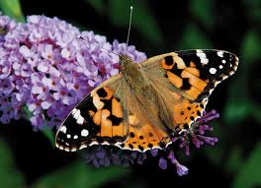
In one week five butterflies hatched.
Here is my brother James
holding a butterfly before
we set them all free.

