Slide 1
MY MEMORIES OF ROAN
BY TESS DALY

Slide 2
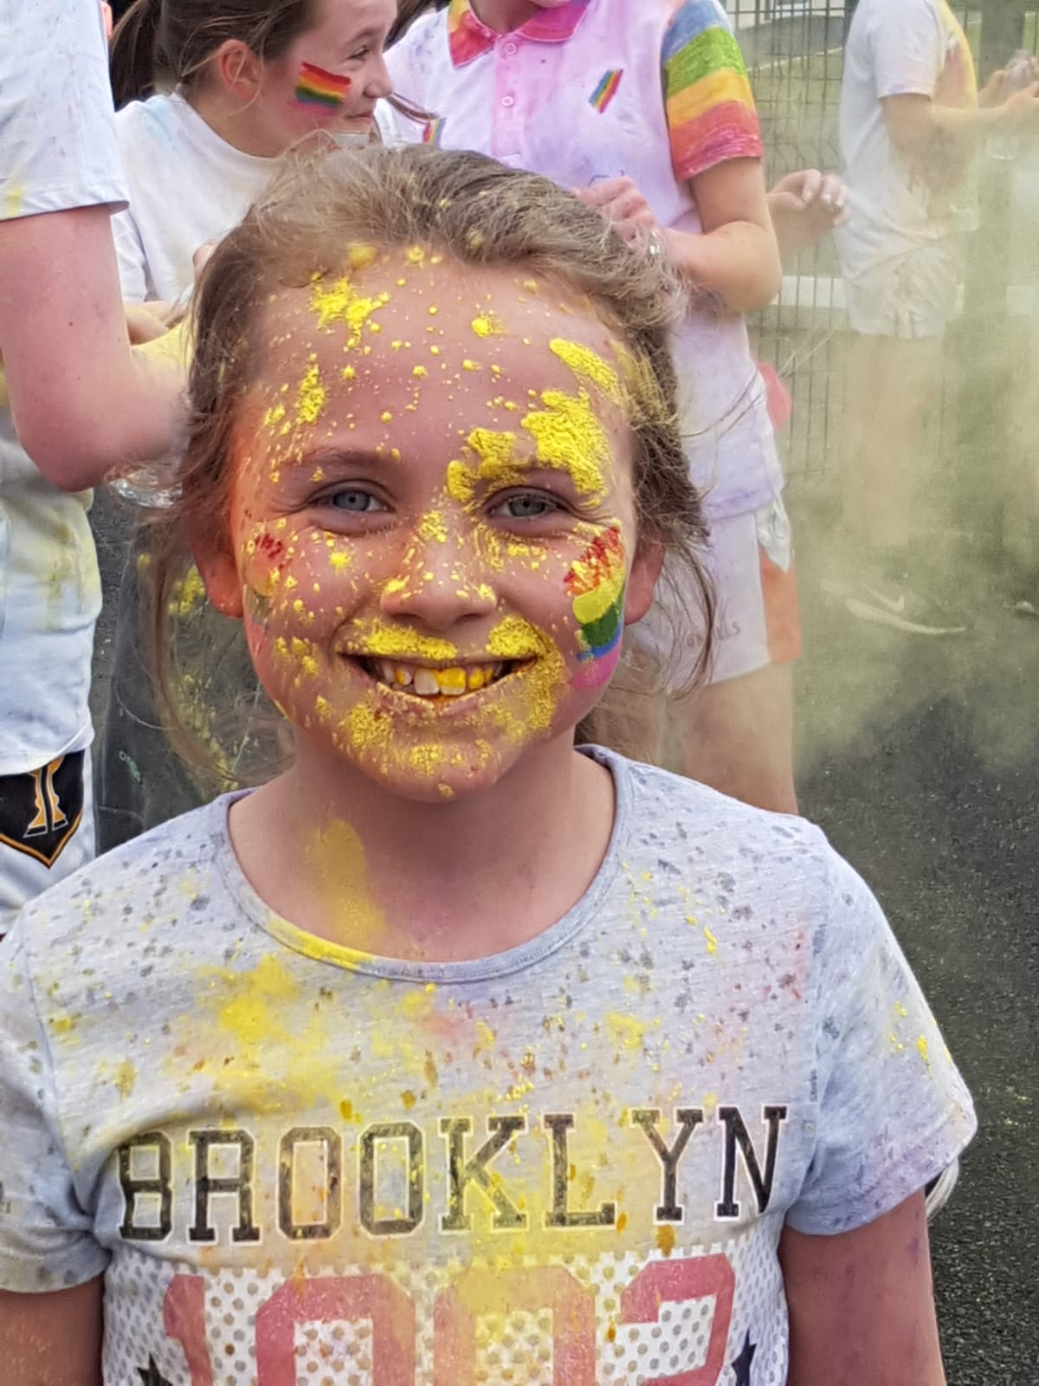
One of my favourite memories of primary school was the colour run that took place last year. It was a great event, we raised a lot of money for the school and it turned out to be a great day out for all the family. Just look at me….. Mr Kavanagh got me right in the face ☺☺

Slide 3
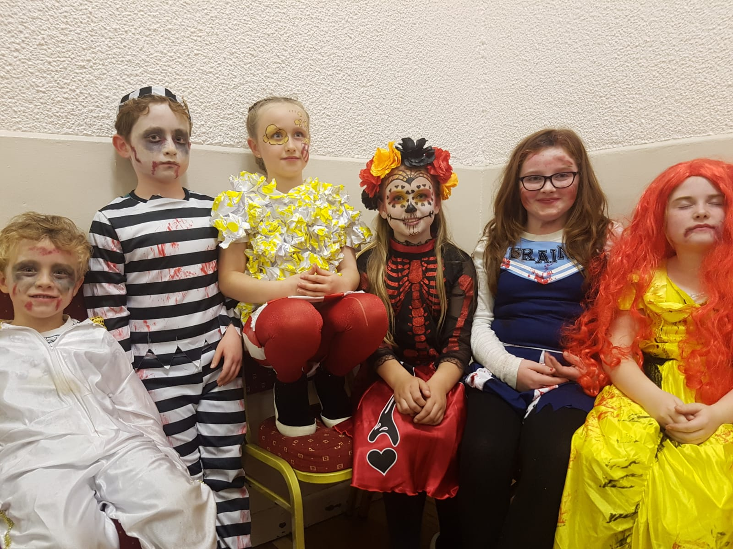
Another good memory was the annual Halloween disco, I loved getting dressed up and taking part in the dance competitions.
We’re all very scary looking aren’t we !!

Slide 4
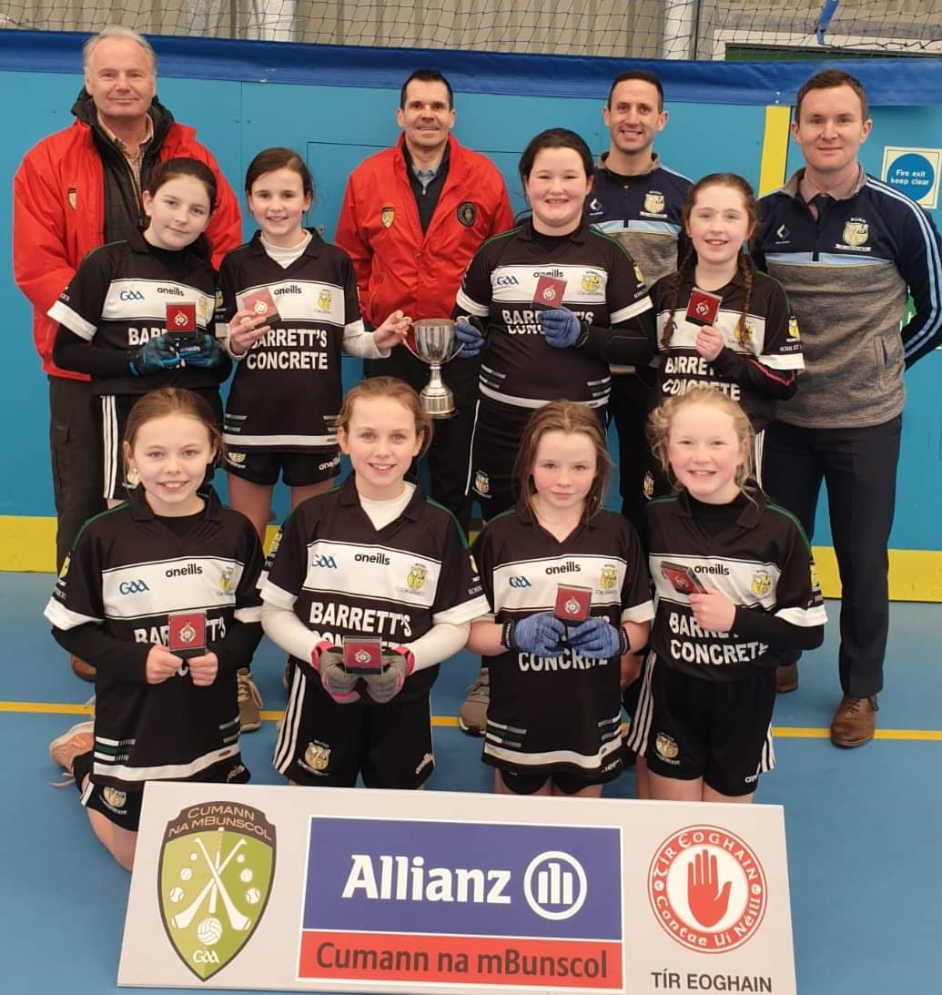
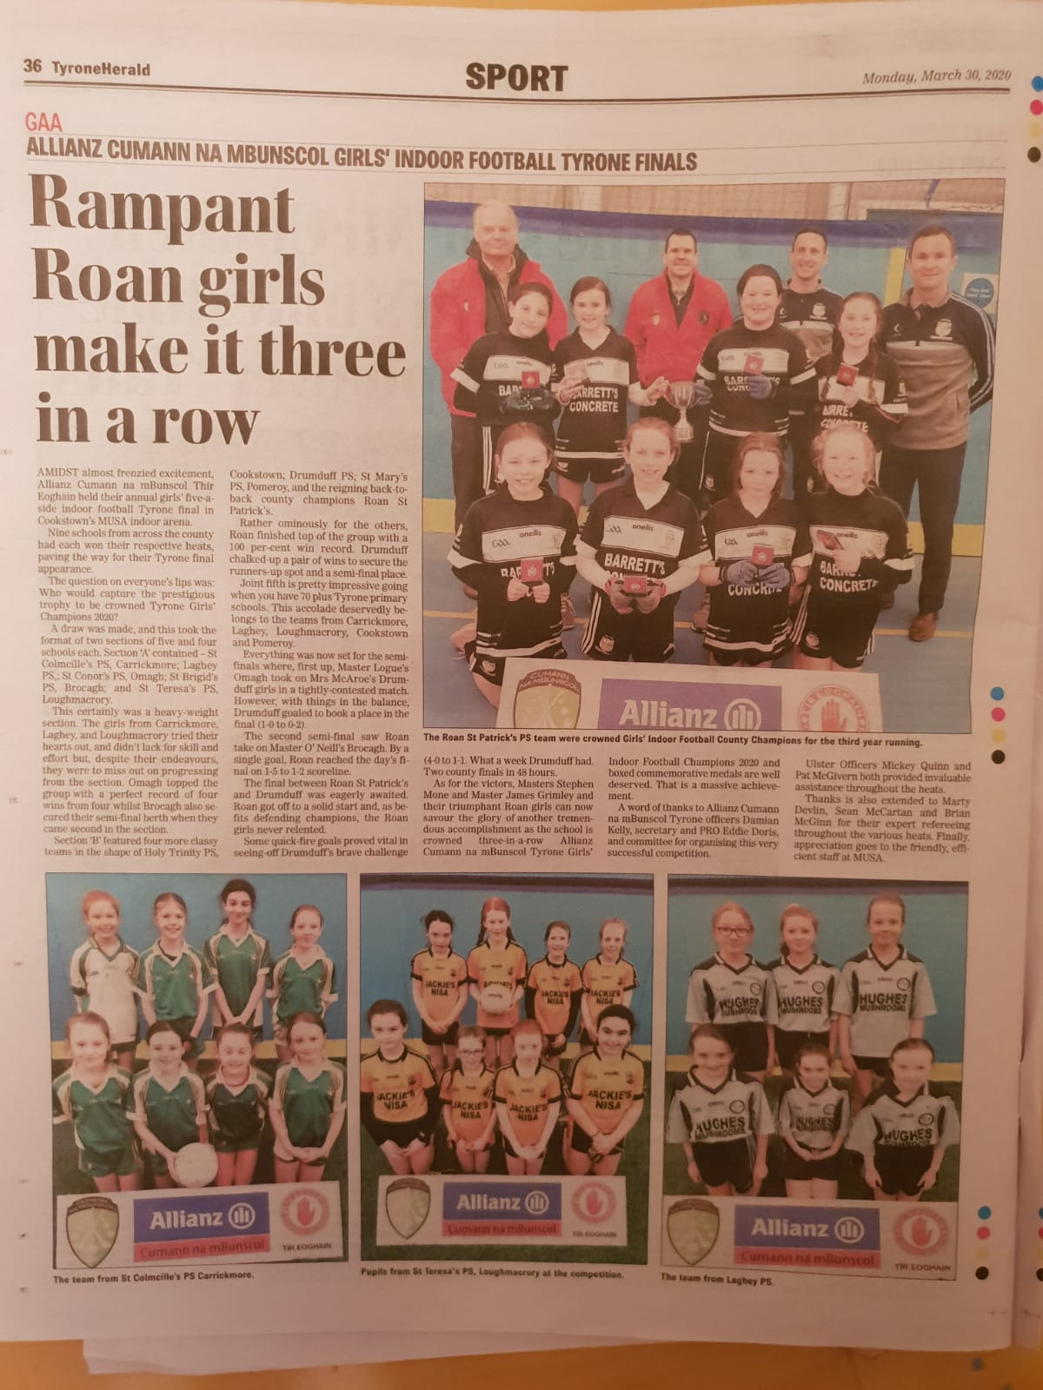
One of the many sporting activities that I took part in was the girls football. Our last match before coronavirus was the Cumann na mbunscol girls indoor county championship which we won for the third year in a row, securing a hat trick for the school!
We even got a full page feature in the local newspaper!!

Slide 5
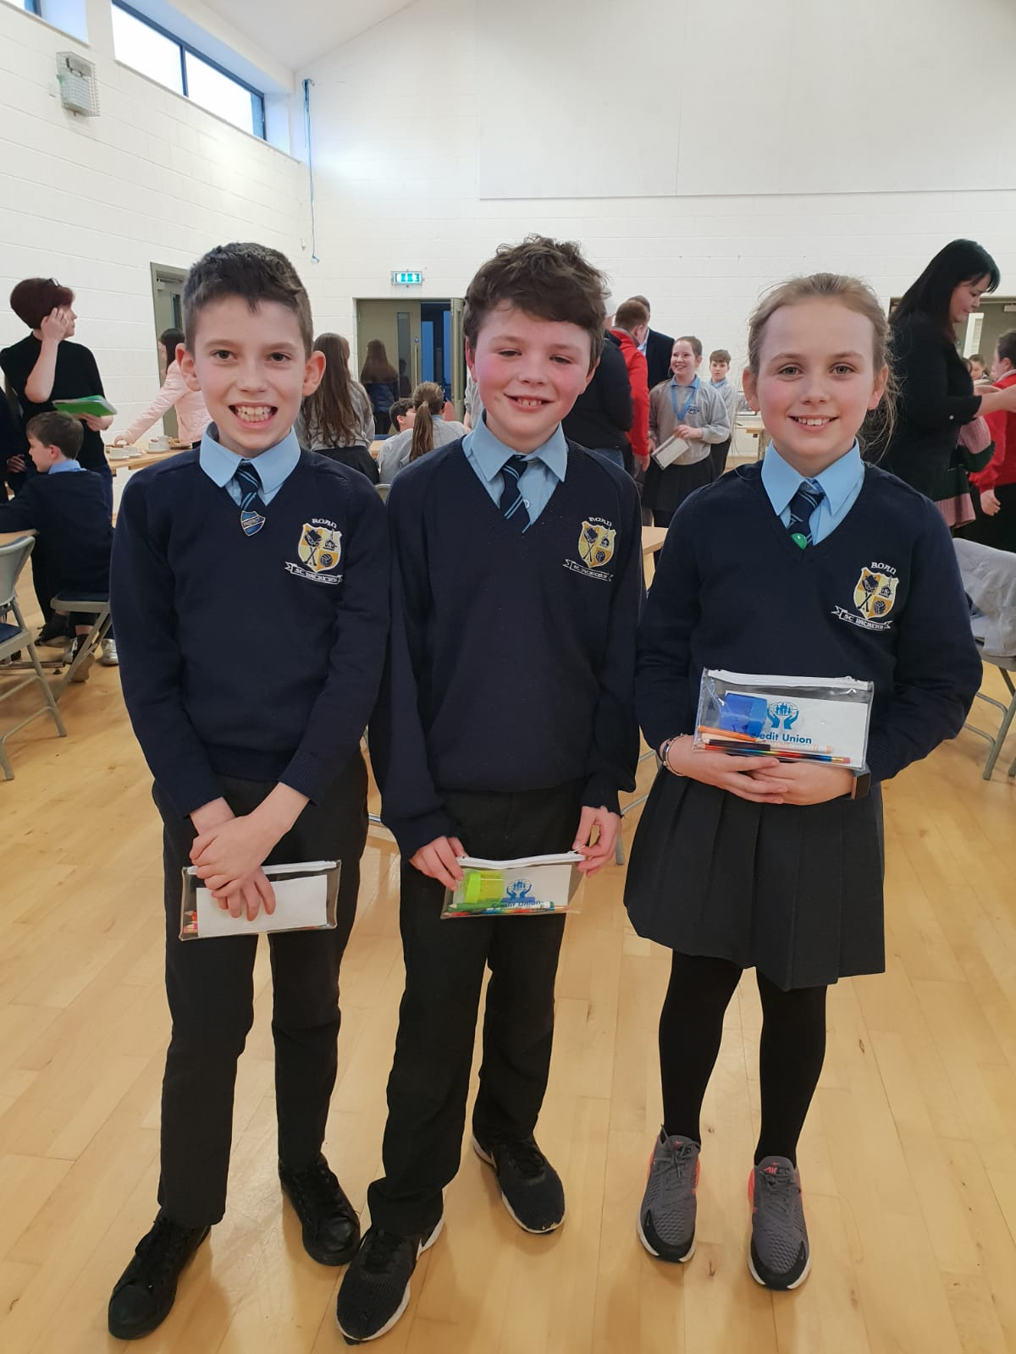
I represented the school alongside jake and joe in the Aughnacloy credit union quiz coming in runners up.
We were feeling nice and let the other team win ☺

Slide 6
On a final note….
I would like to take these last few minutes to thank all of my teachers throughout the years for making my school life very enjoyable and memorable. You have always provided me with the best support and assistance since day 1.
I have been given many opportunities like being a part of the eco and school councils.
As I move on to my new school I hope I enjoy it as much as I have enjoyed my time here at roan st. Patrick’s primary school
Ps. I hope you all miss me next year☺

